Slide 1

Why your blockchain needs an MEV solution
Notes:
In this talk, why your blockchain needs an MEV solution

Slide 2
Blockchains from first principles
Every blockchain has three components:
Virtual Machine
Consensus Mechanism
sequencing: ordering transactions into the next block
attestation: attest to the fork containing that block at the tip, giving it economic weight in the fork choice rule
Block Space Market
Notes:
What is a blockchain?

Slide 3
Why blockspace markets?
Why not infinite blockspace?
Every txn must be replayed and stored by all nodes forever*
To maximize number of participants in a decentralized system, we want to minimize resource consumption to a point where people with consumer-grade hardware and bandwidth can participate (e.g., gas limit)
How to allocate finite blockspace efficiently?
Different market mechanisms: FCFS, batched auctions, etc.
Blockspace market —> sequencing —> attestation —> VM state updated

Slide 4
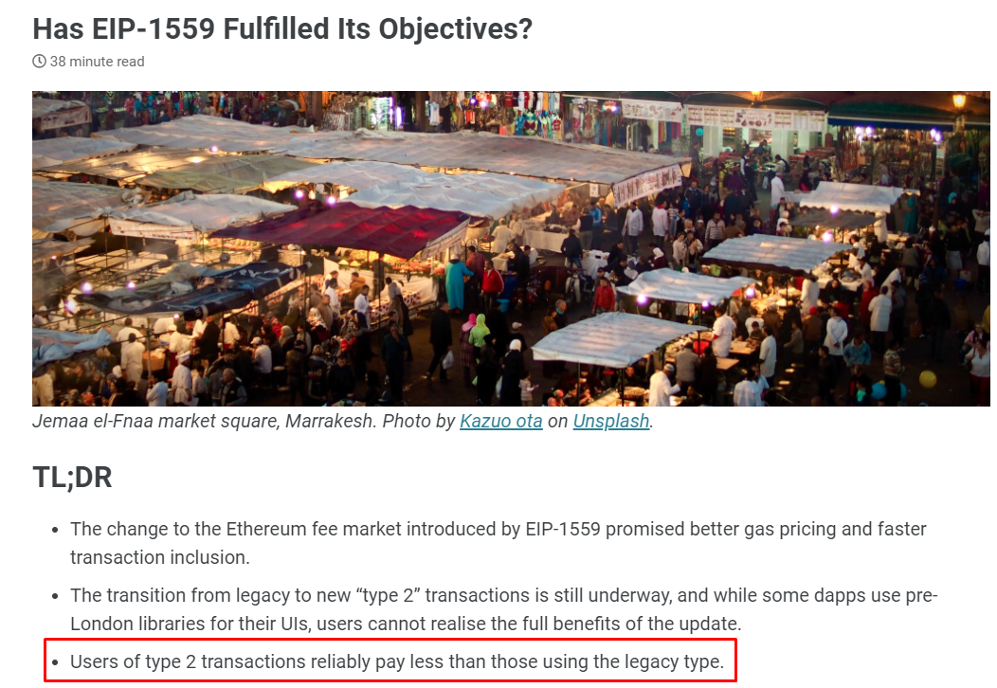

Blockspace market used to be easy…
Original problem: gas price estimation (under/overbidding)
Solution: Introduced EIP-1559, turning market from fixed supply and floating market price to floating supply and fixed market price
This is way better UX!

Slide 5

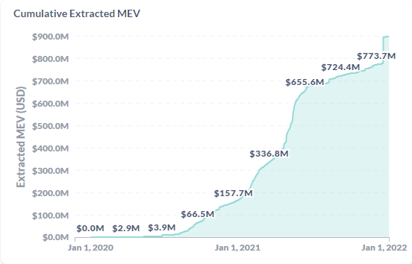
*MEV enters the room*
Notes:
now a substantial part of miner income

Slide 6
MEV transactions have complex preferences for placement
MEV = incentive to insert txns at specific points in the block
Unexpressive market + complex preferences + large incentive = negative externalities
Type of MEV | Target Position
inter-block arbitrage | first in the block
intra-block arbitrage | after target txn (dex trade)
liquidation | after target txn (oracle update)
sandwich | before and after target txn

Slide 7

Choose a market design that minimizes negative externalities
Market Mechanism
Dominant MEV extraction strategy
Negative Externalities
transparent batched auction (PGA)
sealed bid batched auction (flashbots relay)
fcfs / fair ordering
randomized batched auction

Slide 8
Market mechanism | Dominant MEV strategy | Negative externalities
Transparent batch auction | Latency + mempool view | No frontrunning protection Wasted blockspace Block Producer Centralization

Slide 9
Market mechanism | Dominant MEV strategy | Negative externalities
Transparent batch auction | Latency + mempool view | No frontrunning protection Wasted blockspace Block Producer Centralization
Sealed bid batch auction | Best price + gas efficiency | Builder Centralization

Slide 10
Market mechanism | Dominant MEV strategy | Negative externalities
Transparent batch auction | Latency + mempool view | No frontrunning protection Wasted blockspace Block Producer Centralization
Sealed bid batch auction | Best price + gas efficiency | Builder Centralization
Transparent batch auction with low fees and low latency | Vertical integration, colocation, spam | No frontrunning protection Wasted blockspace Block Producer Centralization

Slide 11
Market mechanism | Dominant MEV strategy | Negative externalities
Transparent batch auction | Latency + mempool view | No frontrunning protection Wasted blockspace Block Producer Centralization
Sealed bid batch auction | Best price + gas efficiency | Builder Centralization
Transparent batch auction with low fees and low latency | Vertical integration, colocation, spam | No frontrunning protection Wasted blockspace Block Producer Centralization
FCFS/ fair ordering | Latency, colocation, spam | Wasted blockspace Block Producer Centralization

Slide 12
Market mechanism | Dominant MEV strategy | Negative externalities
Transparent batch auction | Latency + mempool view | No frontrunning protection Wasted blockspace Block Producer Centralization
Sealed bid batch auction | Best price + gas efficiency | Builder Centralization
Transparent batch auction with low fees and low latency | Vertical integration, colocation, spam | No frontrunning protection Wasted blockspace Block Producer Centralization
FCFS/ fair ordering | Latency, colocation, spam | Wasted blockspace Block Producer Centralization
Randomized Batch Auction | Censorship, spam | No frontrunning protection Wasted blockspace Block Producer Centralization

Slide 13
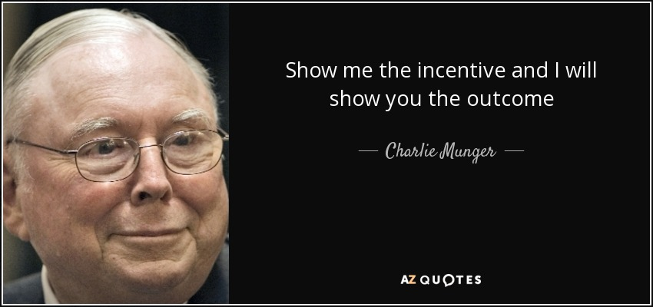

Slide 14
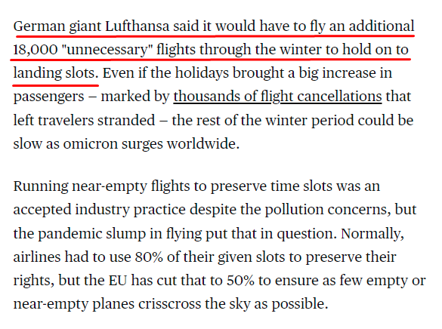
Airline-extractable value (AEV)

Slide 15

Takeaways
MEV exists
Your blockspace market mechanism shapes the dominant extraction strategy for searchers
These extraction strategies create different negative externalities that hurt your users
MEV? Wats dat?
Dear Blockchain architect: Choices have long-run consequences. Build mechanisms that acknowledge MEV
Notes:
https://image.shutterstock.com/image-vector/ostrich-burying-head-sand-banner-260nw-1021873879.jpg

Slide 16
Takeaways
Every blockchain needs fees to prevent spam and allocate scarce resources
Every blockchain needs a way to express complex preferences to accommodate for MEV extraction that doesn't completely wreck your UX
Competition on price is the least harmful and most efficient form of MEV extraction known so far

Slide 17
✨Bonus benefits
If you run a market mechanism that makes competing price the dominant searcher strategy, you will maximize revenue for your block producer(s) (or sequencer, if you‘re an L2!)
By making the searcher market more efficient, you also improve the liquidity and plumbing of your Defi ecosystem
Notes:
Competitive market for searching → most revenue accrues to the block producer instead, can be returned to users, spent on incentives or reinvested in public goods

